Slide 1
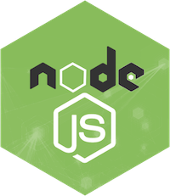
NODE.JS

Slide 2
WHAT IS NODE.JS?
Node.js is a server-side platform built on Google Chrome's JavaScript Engine (V8 Engine).
Node.js was developed by Ryan Dahl in 2009

Slide 3
WHAT IS NODE.JS?
Node.js is an open source , cross-platform runtime environment for developing server-side and networking applications.
Node.js allows us to run JavaScript on the server.
Node.js runs on various platforms (Windows, Linux, Unix, Mac OS X, etc.)

Slide 4
NODE.JS
Node.js =
Runtime Environment
+
JavaScript Library

Slide 5
WHY NODE.JS?
Here is how PHP or ASP handles a file request:
Sends the task to the computer's file system.
Waits while the file system opens and reads the file.
Returns the content to the client.
Ready to handle the next request.

Slide 6
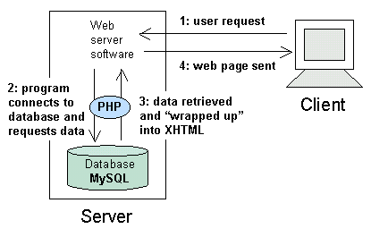

Slide 7
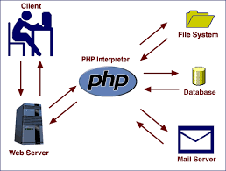

Slide 8
WHY NODE.JS?
Here is how Node.js handles a file request:
Sends the task to the computer's file system.
Ready to handle the next request.
When the file system has opened and read the file, the server returns the content to the client.
*Node.js eliminates the waiting, and simply continues with the next request.
*Node.js runs single-threaded, non-blocking, asynchronous programming, which is very memory efficient.

Slide 9
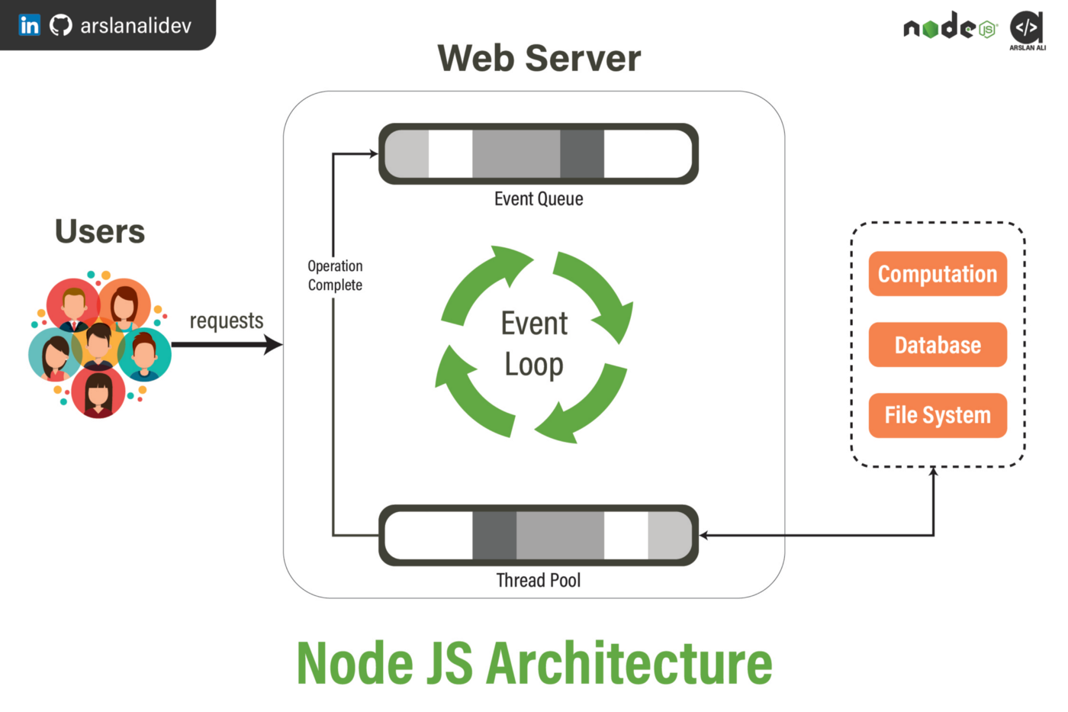

Slide 10
WHERE TO USE NODE.JS?
Following are the areas where Node.js is proving itself as a perfect technology partner.
I/O bound Applications
Data Streaming Applications
Data Intensive Real-time Applications (DIRT)
JSON APIs based Applications
Single Page Applications

Slide 11
FEATURES OF NODE.JS
Asynchronous and Event Driven −ll APIs of Node.js library are asynchronous, that is, non-blocking.
Very Fast − Being built on Google Chrome's V8 JavaScript Engine, Node.js library is very fast in code execution.
Single Threaded but Highly Scalable
No Buffering − Node.js applications never buffer any data. These applications simply output the data in chunks.
License − Node.js is released under the MIT license

Slide 12
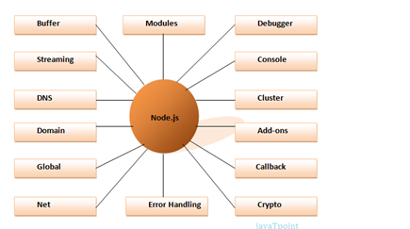

Slide 13
APPLICATIONS OF NODE.JS
Node.js Console
Node.js Web application

Slide 14
CONSOLE BASED APPLICATION
There are three console methods that are used to write any node.js stream:
console.log()
console.error()
console.warn()

Slide 15
NODE.JS CONSOLE.LOG()
The console.log() function is used to display simple message on console.
console.log('Hello Welcome to CSE');
console.log('Hello %s', ‘CSE');
var dept=“CSE”
console.log('Hello %s', dept);

Slide 16
We can also use format specifier in console.log() function.
File: console_example2.js
var a=10;
var b=15;
console.log(a+b);
console.log(Number(a)+Number(b));

Slide 17
GCD OF TWO NUMBERS
const readVal=require('prompt-sync')();
var num1=readVal("Enter Number-1");
var num2=readVal("Enter number-2");
var res=gcd(num1,num2);
console.log('GCD of '+num1+ ' and '+num2+' is '+res);
function gcd(n1,n2)
{
if(!n2)
return n1;
else
return (n2,n1%n2);
}

Slide 18
ode.js console.error()
The console.error() function is used to render error message on console.
File: console_example3.js
console.error(new Error('Hello! This is a wrong method.'));

Slide 19
NODE.JS - REPL TERMINAL
REPL stands for Read Eval Print Loop and it represents a computer environment like a Windows console or Unix/Linux shell where a command is entered and the system responds with an output in an interactive mode.
Read − Reads user's input, parses the input into JavaScript data-structure, and stores in memory.
Eval − Takes and evaluates the data structure.
Print − Prints the result.
Loop − Loops the above command until the user presses ctrl-c twice.

Slide 20
NODE.JS - REPL TERMINAL
Starting REPL
REPL can be started by simply running node on shell/console without any arguments as follows.
$ node
>1 + 3
4 //output
> 1 + ( 2 * 3 ) - 4
3 //output
>

Slide 21
USE VARIABLES
$ node
> x = 10
10
> var y = 10
undefined
> x + y
20
> console.log("Hello World")
Hello World undefined

Slide 22
MULTILINE EXPRESSION
$ node
> var x = 0
undefined
> do
{
... x++;
... console.log("x: " + x);
... }
while ( x < 5 );
x: 1 x: 2 x: 3 x: 4 x: 5
Undefined
>

Slide 23
UNDERSCORE VARIABLE
YOU CAN USE UNDERSCORE (_) TO GET THE LAST RESULT −
$ node
> var x = 10
undefined
> var y = 20
undefined
> x + y
30
>
var sum = _
undefined
> console.log(sum)
30
Undefined
>

Slide 24
REPL COMMANDS
ctrl + c − terminate the current command.
ctrl + c twice − terminate the Node REPL.
ctrl + d − terminate the Node REPL.
Up/Down Keys − see command history and modify previous commands.
tab Keys − list of current commands.
.help − list of all commands.
.break − exit from multiline expression.
.clear − exit from multiline expression.
.save filename − save the current Node REPL session to a file.
.load filename − load file content in current Node REPL session.

Slide 25
ode.js console.warn()
The console.warn() function is used to display warning message on console.
File: console_example4.js
const name = 'John';
console.warn(`Don't mess with me ${name}! Don't mess with me!`);

Slide 26
NODE.JS - NPM
Node Package Manager (NPM) provides two main functionalities −
Online repositories for node.js packages/modules which are searchable on search.nodejs.org
Command line utility to install Node.js packages, do version management and dependency management of Node.js packages.
open console and type the following command to get npm verson
$npm --version

Slide 27
INSTALLING MODULES USING NPM
There is a simple syntax to install any Node.js module −
$ npm install <Module Name>
Example
$ npm install express
$ npm install prompt-sync
Now you can use these module in your js file as following –
var express = require('express');
var prompt = require('prompt-sync')();

Slide 28
GLOBAL VS LOCAL INSTALLATION
By default, NPM installs any dependency in the local mode. Here local mode refers to the package installation in node_modules directory lying in the folder where Node application is present. Locally deployed packages are accessible via require() method.
$ npm ls //shows locally installed
$ ls –l
$ npm install express –g
$ npm ls –g //shoes globally installed

Slide 29
NODE.JS WEB-BASED EXAMPLE
A node.js web application contains the following three parts:
Import required modules − We use the require directive to load Node.js modules.
Create server − A server which will listen to client's requests similar to Apache HTTP Server.
Read request and return response − The server created in an earlier step will read the HTTP request made by the client which can be a browser or a console and return the response.

Slide 30
STEP-1: IMPORT REQUIRED MODULE
To create Node.js web application the required module is “http”.
Import required module: The first step is to use ?require? directive to load http module and store returned HTTP instance into http variable.
For example:
var http = require("http");
In NodeJS, require() is a built-in function to include external modules that exist in separate files.
require() statement basically reads a JavaScript file, executes it, and then proceeds to return the export object.
var myVar = require(‘module_name');
//to use built-in modules
var myVar2 = require('./myLocaModule');
//to use local modules

Slide 31
STEP-2: CREATE SERVER
In the second step, you have to use created http instance and call http.createServer() method to create server instance and then bind with some port number using listen() method associated with server instance.
createServer():
This method turns your computer into an HTTP server.
http.createServer(requestListener);
requestListener:
Specifies a function to be executed every time the server gets a request. This function is called a requestListener, and handles request from the user, as well as response back to the user. It is a Call back function, it will be executed once the server is created.

Slide 32
NODE.JS AS A WEB SERVER
The HTTP module can create an HTTP server that listens to server ports and gives a response back to the client.
Use the createServer() method to create an HTTP server:
http.createServer(function (req, res)
{
//html code,server code…
}
).listen(portno);
OR
var x=http.createServer(function (req, res)
{
//html code,server code…
}
);
x.listen(port_num);

Slide 33
ADD AN HTTP HEADER
If the response from the HTTP server is supposed to be displayed as HTML, you should include an HTTP header with the correct content type:
If the response from the HTTP server is supposed to be displayed as HTML, you should include an HTTP header with the correct content type:
Syntax:
res.writeHead(Status_code, Response_type);
Status_code: 200 (OK or Success), 404 (Error)
Example:
res.writeHead(200,{‘content-type’:’plain/html’});

Slide 34
STEP-3:WRITE A RESPONSE TO THE CLIENT USING RESPONSE OBJECT OF WRITE()
To add a response to the res object or to display data on the web browser use res.write() method.
Syntax:
res.write(“Message”);
Example:
res.write(“Hello”);
res.write(“<h1>welcome</h1>”);
At last to end the response to client need to invoke res.end() method.

Slide 35
EXAMPLE1
var http=require('http');
http.createServer(function(req,res)
{
res.writeHead(200,{'content-type':'text/plain'});
res.write("<body bgcolor='pink'>");
res.write("<h1>welcome to Node js</h1>");
res.end();
}).listen(4040);
console.log("Server 4040 started");

Slide 36
EXAMPLE2
var ser=http.createServer(function(req,res){
res.writeHead(200,{‘content-type’:’text/html’});
res.write(“Hello world”);
res.write(“<br>”);
res.write(“<h1> hi hello</h1>”);
res.end();
});
ser.listen(2020);

Slide 37
WHAT IS MODULARIZATION?
Modularization is a software design technique in which the functionality of a program is separated into independent modules, such that each module contains the desired functionality.
Advantages of modularization:
  Readability
  Easier to debug
  Reusable Code
  Reliability

Slide 38
Node environment provides many built-in modules that can be used in application development.
We have already seen the usage of the "HTTP" module, which is a built-in module in Node.js for creating a web server.
Node.js also provides many other useful modules like
  fs module (used for file-related operations)
  os module(used for operating system-related functions)
  net module( used for socket programming), etc. for server-side application development.

Slide 39
HOW TO CREATE AND LOAD A MODULE IN A NODE APPLICATION.
Step 1: Create a file module1.js within the NodeJS folder created earlier
Program:
  exports.findBiggestNumber = (first, second) => {
  if (first > second)
  {
  return first;
  }
  else
  return second;
  };

Slide 40
Step-2: create module2.js for loading module1.js
const http = require("http");
var lmodule = require("./module2");
var server = http.createServer((req, res) => {
result = lmodule. findBiggestNumber(220, 100);
res.writeHead(200, { "Content-Type": "text/html" });
res.write("<html><body><h1> The Biggest Number of Two Numbers is:" + result + "</h1></body></html>");
res.end();
console.log("Request received");
});
server.listen(3020);
console.log("Server is running at port 3020");

Slide 41
RESTARTING NODE APPLICATION
Whenever we are working on a Node.js application and we do any change in code after the application is started, we will be required to restart the Node process for changes to reflect.
In order to restart the server and to watch for any code changes automatically, we can use the Nodemon tool.
Nodemon
Nodemon is a command-line utility that can be executed from the terminal.
It provides a different way to start a Node.js application.
It watches the application and whenever any change is detected, it restarts the application.

Slide 42
Step-1: Install nodemon
npm install nodemon –g
Once the 'nodemon' is installed in the machine, the Node.js server code can be executed by replacing the command "node" with "nodemon".
nodemon app.js
Thus the 'nodemon' starts the application in watch mode and restart the application when any change is detected.

Slide 43
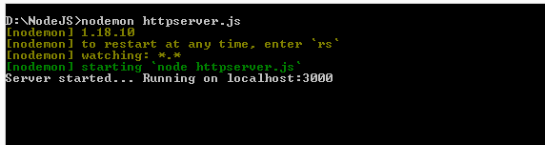
httpserver.js
const http = require("http");
var server = http.createServer((req, res) => {
res.write("Hello World! I have created my first server!");
res.end();
});
server.listen(3000);
console.log("Server started... Running on localhost:3000");
Execution:
Node>nodemon httpserver.js

Slide 44
Now open the application code and do changes in the code as below.
const http = require("http");
var server = http.createServer((req, res) => {
res.write("Hello World! I have created my first server!");
res.write("nodemon Example Program!");
res.end();
});
server.listen(3000);
console.log("Server started... Running on localhost:3000");

Slide 45
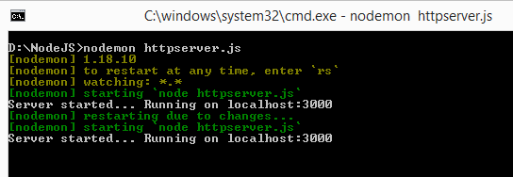
Observe the console message in the command prompt. Nodemon automatically restarted the server on observing changes in the code.

Slide 46
WHAT IS FS MODULE?
The fs module provides a wrapper that contains the standard file operations for manipulating files and dealing with the computing platform's file system.
How to use fs module?
  To include the File System module, use the require() method:
Syntax:
  const fs = require('fs');
File operations are:
  Reading data from a file
  Creating a file
  Writing data to a file
  Updating content in a file
  Delete Files
  Rename Files

Slide 47
READING FILE
  const fs = require('fs');
fs.readFile(fileName [,options], callback)
filename: Full path and name of the file as a string.
options: The options parameter can be an object or string which can include encoding and flag. The default encoding is utf8 and default flag is "r".
callback: A function with two parameters err and fd. This will get called when readFile operation completes.

Slide 48
Exampe:1
var fs = require('fs');
fs.readFile('sample.txt', 'utf8',function (err, data)
{
if (err) throw err;
console.log(data); });
console.log('Open a File to Reading');
Example:2
var fs = require('fs');
var data = fs.readFileSync(‘sample.txt', 'utf8');
console.log(data);
console.log('Open a File to Reading');

Slide 49
Server Application:
var http = require('http');
var fs = require('fs');
http.createServer(function (req, res)
{
//Open a file on the server and return its content:
fs.readFile('sample.txt', function(err, data)
{
res.writeHead(200, {'Content-Type': 'text/html'});
res.write("<h1>"+data+"</h1>");
return res.end();
});
}).listen(3030);

Slide 50
CREATING FILE
  const fs = require('fs');
fs.open(filename, flags[, mode], callback)
filename: Full path and name of the file as a string.
Flag: The flag to perform operation
Mode: The mode for read, write or readwrite. Defaults to 0666 readwrite.
callback: A function with two parameters err and data. This will get called when readFile operation completes.

Slide 51
Flags
The following table lists all the flags which can be used in read/write operation.
Flag | Description
r | Open file for reading. An exception occurs if the file does not exist.
r+ | Open file for reading and writing. An exception occurs if the file does not exist.
rs | Open file for reading in synchronous mode.
rs+ | Open file for reading and writing, telling the OS to open it synchronously. See notes for 'rs' about using this with caution.
w | Open file for writing. The file is created (if it does not exist) or truncated (if it exists).
wx | Like 'w' but fails if path exists.
w+ | Open file for reading and writing. The file is created (if it does not exist) or truncated (if it exists).
wx+ | Like 'w+' but fails if path exists.
a | Open file for appending. The file is created if it does not exist.
ax | Like 'a' but fails if path exists.
a+ | Open file for reading and appending. The file is created if it does not exist.
ax+ | Like 'a+' but fails if path exists.

Slide 52
EXAMPLE
CREATE A NEW, EMPTY FILE USING THE OPEN() METHOD:
Program:
var fs = require('fs');
fs.open('newfile.txt', 'w', function (err, data)
{
if (err) throw err;
console.log('Empty File Created!');
});

Slide 53
WRITING FILE
  const fs = require('fs');
fs.writeFile(filename, data[, options], callback)
filename: Full path and name of the file as a string.
Data: The content to be written in a file.
options: The options parameter can be an object or string which can include encoding, mode and flag. The default encoding is utf8 and default flag is "r".
callback: A function with two parameters err and fd. This will get called when write operation completes.

Slide 54
CREATING & WRITING FILE
var fs = require('fs');
fs.writeFile('test.txt', 'Hello World!', function (err) {
if (err)
console.log(err);
else
console.log('Write operation complete.');
});

Slide 55
APPEND FILE CONTENT
var fs = require('fs');
fs.appendFile('test.txt', 'welcome to node js!', function (err) {
if (err)
console.log(err);
else
console.log('Append operation complete.');
});

Slide 56
RENAME FILES
  const fs = require('fs');
fs.rename(existingfilename, newfilename, callback)
var fs = require('fs');
fs.rename('test.txt', 'modify.txt', function (err) {
if (err)
console.log(err);
else
console.log('File Name Changed !');
});

Slide 57
DELETE FILE
  const fs = require('fs');
fs.unlink(filename, callback)
var fs = require('fs');
fs.unlink('sample.txt', function (err) {
if (err)
console.log(err);
else
console.log('File Deleted !');
});

Slide 58
Copy file content:
var fs = require('fs');
fs.readFile('sample.txt', 'utf8',function (err, data)
{
if (err) throw err;
console.log(data);
fs.writeFile('test.txt', data, function (err) {
if (err)
console.log(err);
else
console.log('Write operation complete.');
});
});
console.log('Open a File to Reading');

Slide 59
Merge file data
var fs = require('fs');
var content="";
fs.readFile('sample.txt', 'utf8',function (err, data)
{
if (err) throw err;
content=content+data;
console.log('First File Data Copied.'+content);
fs.readFile('test.txt', 'utf8',function (err, data)
{
if (err) throw err;
content=content+data;
console.log('Second File Data Copied.'+content);
fs.writeFile('mergefile.txt', content, function (err)
{
if (err)
console.log(err);
else
console.log('Merge operation complete.'+content);
});
});
});

Slide 60
WHAT IS EXPRESS.JS
Express.js is a web framework for Node.js.
Express.js is a fast, assertive, essential, robust and asynchronous in nature.
we can assume express as a layer built on the top of the Node.js that helps manage a server and routes.
It provides a robust set of features to develop web and mobile applications.

Slide 61
FEATURES:
Robust routing
Focus on high performance
Super-high test coverage
HTTP helpers (redirection, caching, etc)
View system supporting 14+ template engines
Content negotiation
Executable for generating applications quickly

Slide 62
INSTALL EXPRESS.JS
Step-1:Use the following command to install express framework globally.
Syntax:
C:\users> npm install -g express
Step-2: Installing Express
Use the following command to install express:
Syntax:
C:\users> npm install express --save

Slide 63
We should install some other important modules along with express. Following is the list:
body-parser: This is a node.js middleware for handling JSON, Raw, Text and URL encoded form data.
C:\Users>npm install body-parser --save
cookie-parser: It is used to parse Cookie header and populate req.cookies with an object keyed by the cookie names.
C:\Users>npm install cookie-parser --save
multer: This is a node.js middleware for handling multipart/form-data.
C:\Users>npm install multer --save

Slide 64
EXAMPLE:
var express = require('express')
// create express application instance
var app = express()
// express route
app.get('/', function (req, res) {
res.send('This is a Sample Example for Express.js ')
})
var server = app.listen(8000) // start server

Slide 65
This particular route handles GET requests: app.get.
This route is run for the path '/'.
The function function(req, res){} gets executed when a client sends a GET request for the path ‘/’. The req and res hold the request and response objects respectively for this GET request.
res.send() sends the argument to this function as response to the client.

Slide 66
Route Method:
The application object has different methods corresponding
to each of the HTTP verbs (GET, POST, PUT, DELETE).
These methods are used to receive HTTP requests.
Below are the commonly used route methods and their
description:
Method | Description
get() | Use this method for getting data from the server.
post() | Use this method for posting data to a server.
put() | Use this method for updating data in the server.
delete() | Use this method to delete data from the server.
all() | This method acts like any of the above methods. This can be used to handle all requests.

Slide 67
EXPRESS.JS ROUTES
An Express.js Route defines how our Express application can respond to a client request to with a specific URI (or path) and a specific HTTP request method (GET, POST, etc.).
Create a basic Express application as shown beow.
    var express = require('express')
    var app = express()
    var server = app.listen(8000, function(){
    console.log('Listening on port 8000...');
    })

Slide 68
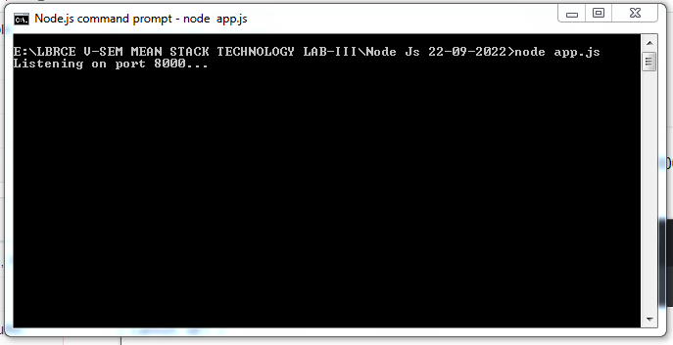
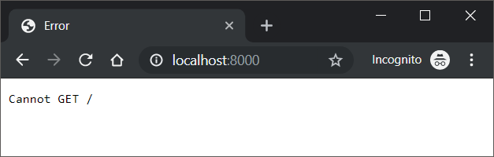
In the above Express application, we started the server, but did not define what has to happen when a request hits the server.

Slide 69
This is where Express.js Routes come into picture. Following is a simple express route.
app.get('/', function (req, res) {
res.send(' This is a Sample Example for Express.js ')
})
    var express = require('express')
    var app = express()
app.get('/', function (req, res) {
res.send(' This is a Sample Example for Express.js ')
})
    console.log('Listening on port 8000...');
    var server = app.listen(8000)

Slide 70
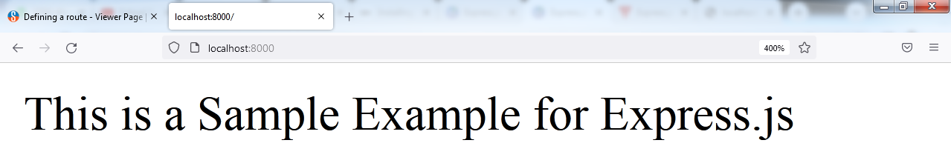
What does this route define? This route defines that, execute the statements inside the function, when you receive a GET request with request url as /.

Slide 71
In the following program is a route, where the function is executed for a GET request with request url /welcome/ (or) /hello/ (or) /bye/ (or) /thank you/
var express = require('express')
var app = express()
// route that gets executed for GET request and the request url path '/' or root
app.get('/', function (req, res) {
res.send('This is a Sample Example for Express.js .')
})
// route that gets executed for GET request and the request url path '/hello/'
app.get('/welcome/', function (req, res) {
res.send('Welcome to node express.js.')
})
// route that gets executed for GET request and the request url path '/bye/'
app.get('/hello/', function (req, res) {
res.send('hello page.')
})
// route that gets executed for GET request and the request url path '/bye/'
app.get('/bye/', function (req, res) {
res.send('bye page.')
})
// route that gets executed for GET request and the request url path '/bye/'
app.get('/thank/', function (req, res) {
res.send('Thank you page.')
})
// start the server
var server = app.listen(8000, function(){
console.log('Listening on port 8000...')
})

Slide 72
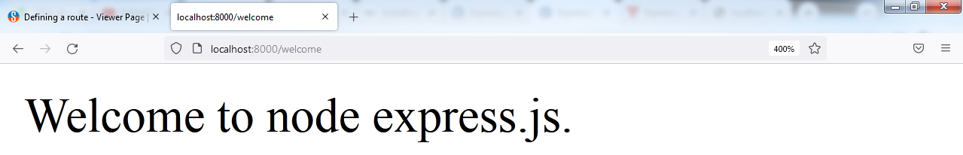
GET request with URL path http://localhost:8000/
GET request with URL path http://localhost:8000/welcome

Slide 73
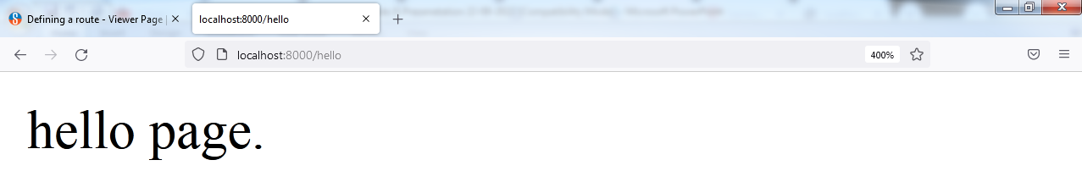
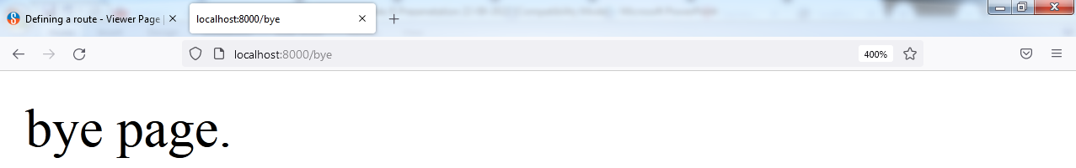
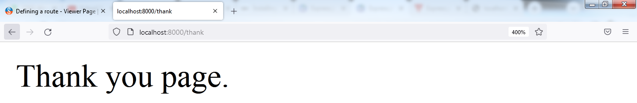
GET request with URL path http://localhost:8000/hello
GET request with URL path http://localhost:8000/bye
GET request with URL path http://localhost:8000/thank

